Slide 1
CAR Review: Team Activity
December 2014

Slide 2
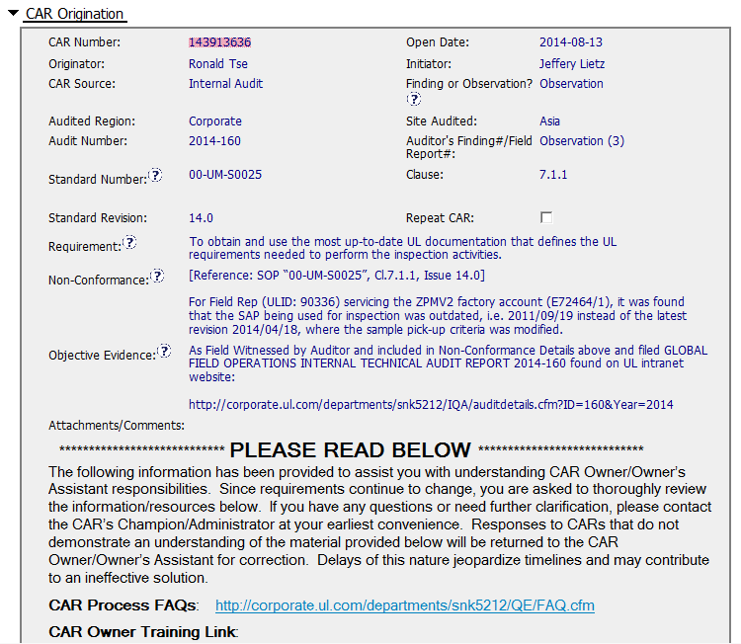
CAR 143913636 - Observation
Finding as new process is not being followed ?
Guidance provided

Slide 3
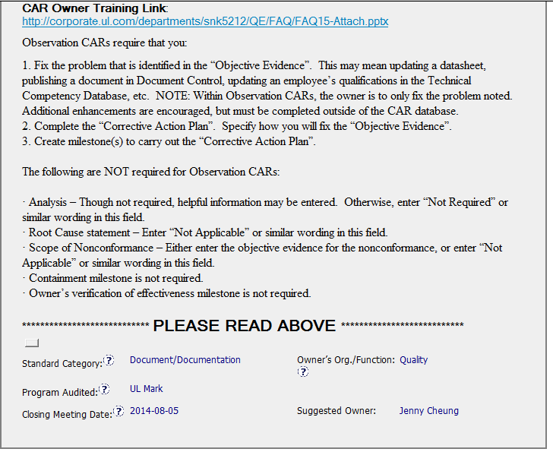
CAR 143913636 - Observation
Most appropriate owner
- Field Specialist ?

Slide 4
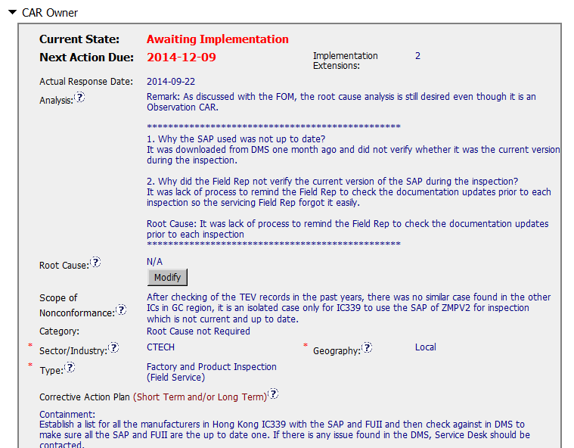
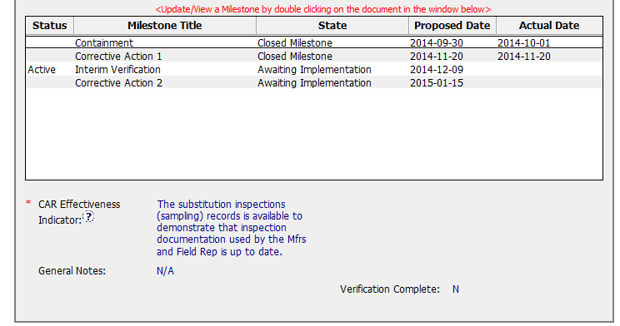
CAR 143913636 - Observation
Indicates a Finding is required
CA 1: No evidence of document control
CA 2: Is it Verification ?

